Slide 1
SMART LENDER - APPLICANT CREDIBILITY PREDICTION FOR LOAN APPROVAL
Mentor :
Dr. Ponsy R K Sathia Bhama
Team Members:
K Bhavani Venkata Karthik (2019503511)
Amaresh Saddish (2019503004)
Tanooj Cheekati (2019503056)
Shreayas Karthik Ramesh (2019503050)

Slide 2
Introduction
Machine learning is currently being actively used in banking and financial institutions for a variety of purposes, including trading, portfolio management, fraud detection, and loan approval.
Loan providers, especially big businesses like banks and insurance companies, train machine learning algorithms using a tonne of consumer data and financial lending outcomes
According to a data analysis perspective, determining whether to approve a loan is a "good" or "bad" risk depends on the analysis and classification of a set of loan applicant data.
A set of data is divided into two classes using the binary classification method, which is a straightforward classification case.

Slide 3
Objectives
Develop a multi-classification model that evaluates more than 2 features and gives a detailed report for loan approval.
Developing a loan approval system that can provide a possible reason for rejection
Develop a loan approval system that can predict loan approval based on expert data.

Slide 4
Literature Survey

Slide 5
Comparative Analysis of Customer Loan Approval Prediction using Machine Learning Algorithms
In this study, machine learning (ML) algorithms are used to retrieve patterns in predicting future loan defaulters from a common loan approved dataset.
The analysis will be done using historical customer data, including their age, income, loan amount, and length of employment.
Several ML algorithms, including Random Forest, Support Vector Machine, K-Nearest Neighbor, and Logistic Regression, were used to identify the most pertinent features, or those that had the greatest influence on the prediction outcome.

Slide 6
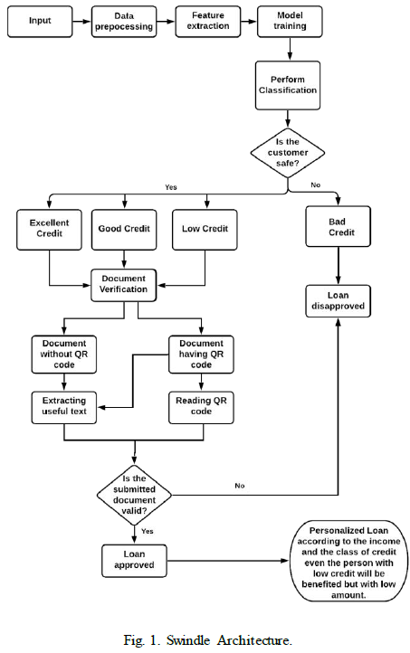
Swindle: Predicting the Probability of Loan Defaults using CatBoost Algorithm
Swindling tools by combining the CatBoost algorithm with a document verification module that uses Tesseract and Camelot as well as a personalised loan module, financial institutions can reduce the risk associated with providing loans to defaulters and unapproved customers.

Slide 7
Tree-Based Methods for Loan Approval
The goal of this work was to create a decision tree-based high performance predictive model for loan approval prediction. Experiments were conducted using a variety of tree methods, from the simplest and most understandable decision tree to the most intricate random forests.
Due to the highlight correlated and complex feature space, which resulted in an overly simplified tree that was impractical to use, the results showed insufficient performance with respect to simplified decision trees. But boosting won out in terms of effectiveness, applicability, and interpretation.
As a result, it was advised to use a boosting-based decision-tree predictive model to make decisions about the eligibility of loan applicants based on those applicants' characteristics.

Slide 8
Empathy Map

Slide 9
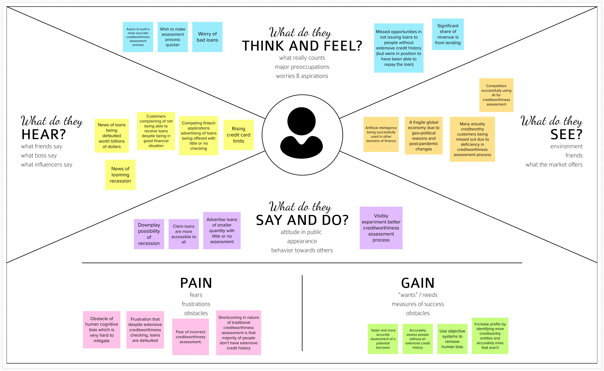

Slide 10
Thank You

